Slide 1
BUSINESS INTELLIGENCE 381 G. Mudare

Slide 2
Power BI Steps

Slide 3
Using the Query Editor in Power BI Desktop
When you launch Power BI Desktop and look at the interface, you will probably notice that it has a very Microsoft‐like feel to it, with a Ribbon and a series of
Tabs.
And, as is usual on a Microsoft Ribbon, the Home Tab contains all the most frequently used options.

Slide 4
Power BI Desktop
The first thing you do, when you are working on any kind of project in Power BI Desktop, is to grab some data.
do this by going to the Home Tab, clicking on Get Data and choosing the appropriate option.

Slide 5
Using the Query Editor in Power BI Desktop
Open the file called “CarDamage.xlsx".
It contains two worksheets.
The first (“CarDamage") contains lists each of the areas of a fleet of car hire vehicles which have scratches and scrapes.
The second sheet ("Vehicles") gives details about each vehicle; it tells us the make, the model and at which branch the vehicle is stored

Slide 6
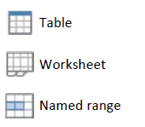
Using the Query Editor in Power BI Desktop
Connecting to an Excel File
In the home Tab of the Ribbon, click on Get Data and choose Excel.
Navigate to data folder double‐click on “CarDamage .xlsx" to import it.
When the Navigator appears, you will see the two worksheets
There are three types of Excel object which are recognized:
Worksheets,
Tables
Named Ranges.
The table icon has a blue bar at the top.
The worksheet icon has tiny sheet tabs in the bottom left.
The named range icon has a light blue shading in the middle of the icon.

Slide 7
Using the Query Editor in Power BI Desktop
On this occasion, we want to import two worksheets; so,
click in both checkboxes to activate them. You can either click on Load, which will make the worksheets available for immediate use, so you can start building your report straightaway; or
You can click on the Edit/Transform Data button, which will take us into the Query Editor.
Do the latter.

Slide 8
Using the Query Editor in Power BI Desktop
In the Query Editor, we can make all manner of transformational changes to the data as it is brought into Power BI.
Query Editor allows you to set up a series of rules which will be applied whenever you connect to a data source.
Some of these rules are created automatically; and are listed on the right in the Query Settings pane: "Source”, “Navigation", "Promoted Headers“ and "Changed Type".
These steps were generated automatically when the data was brought into the Query Editor.

Slide 9
Using the Query Editor in Power BI Desktop
Creating a Custom Column in the Query Editor
Perform one additional transformation
Add an extra column to the "vehicles" table which displays both the make and the model of each vehicle.
Make sure that the "Vehicles" query is highlighted in the Queries pane on the left of your screen; then click on the Add Column Tab.
Click on Custom Column and, at the top of the "Add Custom Column" dialog, enter the name "Make and Model".

Slide 10
Using the Query Editor in Power BI Desktop
Query Editor Concatenation
The model of a car is purely numeric.
Concatenation, operation can only be performed on textual values and thus you may get an error
To get rid of an error, you may need to remove all the steps you have performed; or sometimes go back to a previous step, perform an additional step and correct the error that way.
fix this error using the latter method
Click on the "Changed Type" step. (notice what the data looked before this step
make this column a text column, by clicking on the left of the column heading and choose Text from the context menu; and, when the dialog appears, confirm that you would like to insert a new step.
go back to the final step, and see that the errors have disappeared

Slide 11
Query Editor and Power BI Desktop Windows
When you are working in the Query Editor, you always have two Power BI windows open;
the Query Editor window
the report window,
If you make changes in the Query Editor you have to apply those changes, else a yellow bar will always be displayed until you apply your changes.
go to the File menu, and click Close & Apply.

Slide 12
Creating a Report in Power BI Desktop

Slide 13
Creating a Report
Now have two tables loaded into the data model available for building reports.

Slide 14
Creating a Report in Power BI Desktop
Report, Data and Model View
On the left, we have three views in which we can work. In the illustration above, we are in report view, which is where we will be building our report.
Below Report view, we have Data view, which allows you to look at the data within each of your tables.
Click on the name of a table in the Fields Pane on the right to obtain a data preview
We have Model view, in which you can create relationships between tables that have columns in common

Slide 15
Report, Data and Relationships View
Hover over the line joining the two tables and see the relationship that was created.
Return to Report view and
Go ahead and build our report.
We have a wide variety of visuals at our disposal and additionally we can use custom visuals;

Slide 16
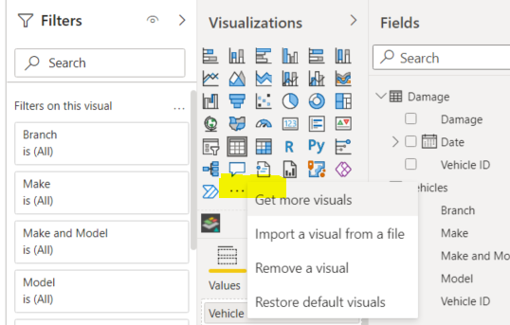
Power BI Custom Visuals
Power BI custom visuals are visuals which have been developed by either by Microsoft themselves or by the Power BI community and made available free of charge to anyone who is using Power BI Desktop.
Click on import and, in the exercises folder, you will find the Synoptic Panel which is the visual that we will be using.
Simply double‐click on it to import it.
Once a visual is imported, you will see a new icon, which represents the imported custom visual,
To use the custom visual, click on its icon.

Slide 17
Creating a Report in Power BI Desktop
To get an idea of how the custom visual works, let us look at the completed report that we will be creating.

Slide 18
Synoptic Panel custom visual
The Synoptic Panel custom visual is designed to display a data driven graphic.
The graphic must be saved in SVG format.
SVG (Scalable Vector Graphics) is web graphic format which, unlike most web graphic formats, is vector based.

Slide 19
Scalable Vector Graphics
Each of the areas
which are coloured has a name (and SVG ID) which corresponds to one of the entries that we can see in the damage column.
SVG requires you to create a correspondence between the named shapes within the SVG file and the entries in one of the columns within your dataset.
If we go back to the report and hover over front left door within the graphic, the tooltip displays "Front L Door"; and we can see that, in the entire fleet, there is a total of 22 cars which have scratches on that part of the vehicle.

Slide 20
Populating the Synoptic Panel
Our visual requires two key fields: Category and Measure.
First, we need the Damage field from the Damage table to go into the Category field of the visual.
This is the field which will supply the text labels to be displayed on the shapes indicating the different areas of damage on the car.

Slide 21
Populating the Synoptic Panel
Click on the visual and drag the Vehicle ID field from the Damage table into to the Measures field of the visual;
Specify that we want to count the Vehicle IDs;

Slide 22
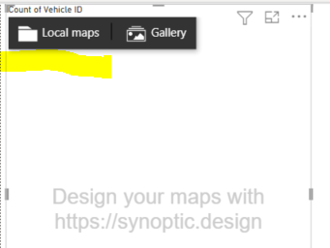
Populating the Synoptic Panel
To get a graphic into the visual; and there are a couple of buttons on the visual for this purpose:
We can either select Local Maps, a graphic of our own choosing; or we can use a graphic from the Gallery supplied by the creators of the visual
Select your own image;
Click on the Local Map button, navigate to the exercises folder and select our SVG file (Car damage.svg).

Slide 23
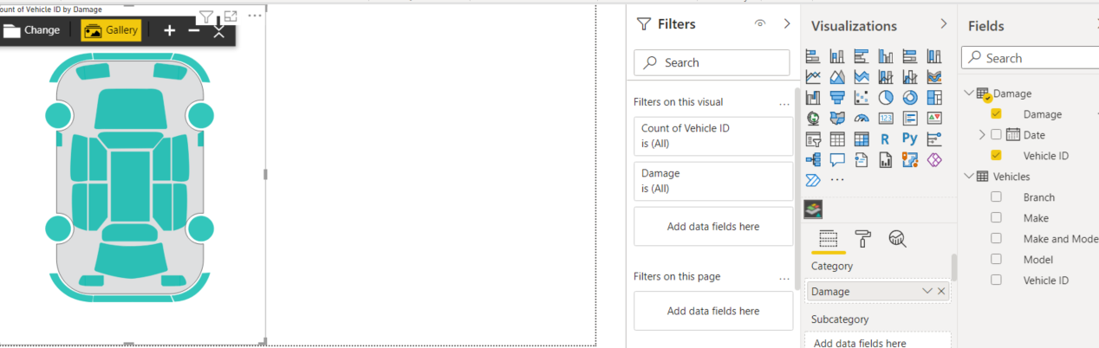
Populating the Synoptic Panel
hover over any green areas

Slide 24
display the numbers permanently
To display the numbers permanently switch over from the Fields Tab to the Format Tab
Activate and expand the Data Labels option and
Change the Display from Data Column to Data Value.
Scroll down and use the arrow controls to make the text in the labels a bit larger.

Slide 25
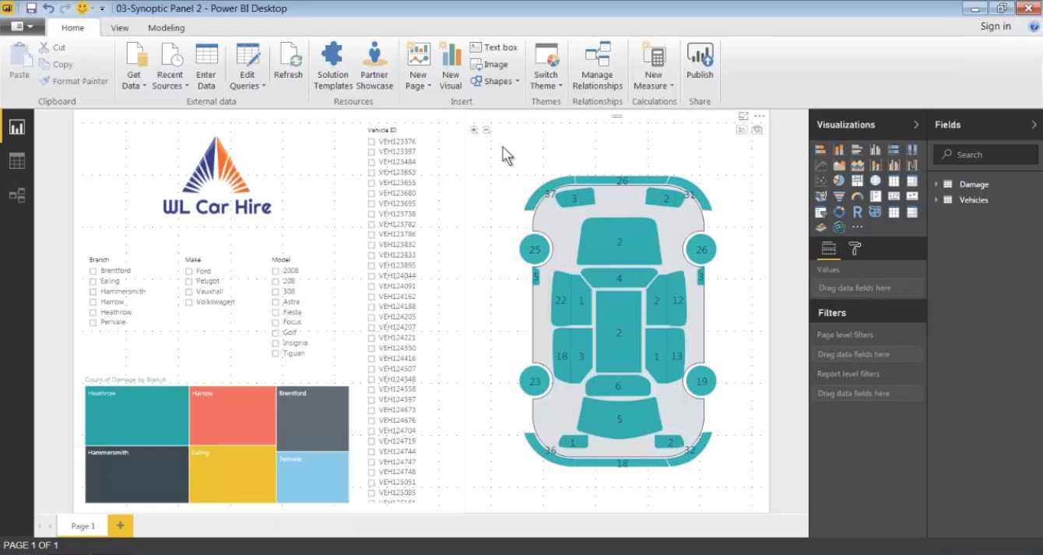
ADDING SLICERS VISUAL
Add some slicers which will enable the user to filter the amount of damage which is displayed on the car
Make the text in the slicer bigger; so, again, we go across to the Format Tab of the Visualizations pane and, this time, we expand the Items section and let us make the text size 12 point, instead of the default 10.
Your report should look like this

Slide 26
PRACTICE
Add other visuals to your report so that it looks like the one on the screen
Feel free to change colour schemes and add more visuals to make your report more appealing.

